Slide 1
FactoryTalk ® TeamONE™
The App for team productivity - Architecture Examples
October 4th, 2016

Slide 2
FactoryTalk ® TeamONE™
In this document there are three (3) options of network setups that will help you realize the benefits of the TeamONE app. You will be able to use different modules depending on the architecture you select.
  Network Architecture Example 1 – Collaboration Modules. You need internet access for these modules.
  Network Architecture Example 2a & 2b – Device Troubleshooting Modules. You need access to the plant network for these modules.
  Network Architecture Example 3 – All modules through a unified in band setup. This setup requires access to both the internet and the plant network.
If you have any questions or comments just email ramobilesupport@ra.rockwell.com and we’ll help you out!

Slide 3

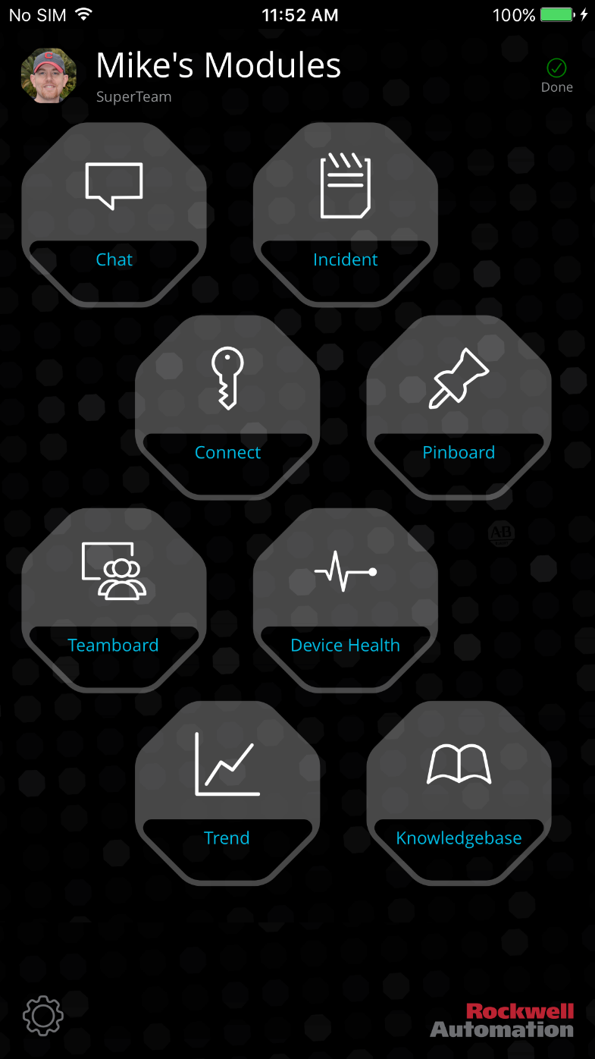




TeamONE syncs to team DB in FactoryTalk Cloud!
Login and team creation done online.
1
Download App on cell
or Wi-Fi enabled device
2
Create OR join team
3
Use with internet
FUNCTIONAL MODULES
ARCHITECTURE 1

Slide 4




Network Architecture Example 1
Collaboration Modules only - The following examples show sample network architectures of how you can achieve this
Option 1
Option 2
TeamONE
WiFi iOS or Android device (refer to supported device list) with cellular data service.
WiFi only iOS or Android device (refer to supported device list)
IT Wifi
Preview release module details:
Chat– Chat with any team member.
Teamboard – Post to all team members
Incident – Record issues with machines or products
Pinboard – Favorite board of incidents
KnowledgeBase – Automatic login to KB for articles.
Office Laptop
SmartPhone WiFi only devices for Project Stanton
(Collaboration only)
SmartPhone cell service devices for Project Stanton
(Collaboration only)

Slide 5




Login and team creation done ‘online’. No device data is synced.
1
Download App on cell
or Wi-Fi enabled device
2
Create team of one (1) or more
3
Connect to an in panel
wifi network
FUNCTIONAL MODULES
ARCHITECTURE 2

Slide 6






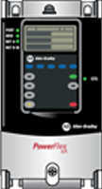
Network Architecture Example 2
Device Modules - The following examples show sample network architectures of how you can achieve this
Out of band - ‘In cabinet’ WiFi access point with or without cloud access.
Optional Sync
Optional Sync
Option 2a - Autonomous
When device disconnects from local Wi-Fi
Option 2b - Unified
When device disconnects from local Wi-Fi
TeamONE
Recommended - WiFi only iOS or Android device (refer to supported device list)
WiFi iOS or Android device (refer to supported devices list) with cellular data service. All modules will be available BUT this will NOT SYNC ANY DEVICE DATA TO THE CLOUD and the user has to disconnect from the local Wi-Fi for sync to occur.
Cell/Area Zones - Levels 0-2
(Lines, Machines, Skids, Equipment)
SmartPhone devices for TeamONE
(Monitoring & collaboration)
Cell/Area Zones - Levels 0-2
(Lines, Machines, Skids, Equipment)
SmartPhone devices for TeamONE
(Monitoring & collaboration)
WLC (Active)
Distribution switch
Distribution switch
WLC (Standby)
IES
IES
AP
IES
IES
LWAP
IES
IES
IES
IES
TeamONE module details using WiFi only:
Device Health – Connect to any Ethernet IP device and read high level status. Parameter tab shows up in device details page for Powerflex 525 or 755 only.
Trend – Connect Powerflex 525 or 755 only and do a real time trend of any parameter.
IES
Laptop for Programming (Studio 5000)
IES
Laptop for Programming (Studio 5000)
Controller
WGB
Controller
WGB
FactoryTalk Client
I/O
Drive
Controller
Controller
FactoryTalk Client
I/O
Drive
Controller
Controller
AP = Access Point (locally managed) recommended MAC filtering, no broadcast SSID, WPA2
LWAP = Lightweight Wireless Access Point
WLC – Wireless Lan Controller – This manages the security policies, access control, etc. centrally

Slide 7





TeamONE serves as gateway for modules that sync via cloud.
No device data is synced.
1
Setup firewall between
OT & IT networks
2
Ensure ports are open for sync & push messaging enabled
3
Add devices to OT wireless
network with no SIM chips
FUNCTIONAL MODULES
4
Download App
DMZ
5
Create & Join Team
IT NETWORK
6
Use route to cloud
via firewall
OT NETWORK
ARCHITECTURE 3

Slide 8

Network Architecture Example 3
All modules - The following examples show sample network architectures of how you can achieve this
Unified in band setup
Enterprise
WAN
Internet
External
DMZ / Firewall
WLC (Enterprise)
ISE PAN/PSN
Enterprise Zone: Levels 4-5
Core switches
ISE MnT
Industrial Demilitarized Zone (IDMZ)
TeamONE
Firewalls
(Active/Standby)
Port 443 (TeamONE DB sync back and forth to cloud)
Ports 5223, 2195 & 2196 for Apple Push Messaging
Ports 5228,5229,5230 for Google/Android Cloud Messaging
All the devices running the App Platform within the OT network will need to access these ports.
Industrial Zone
Levels 0-3
(Plant-wide Network)
Core switches
ISE PSN
WLC (Active)
WLC (Standby)
Level 3
Site Operations
Distribution switch
Wi-Fi only iOS or Android device (refer to supported device list)
IES
IES
LWAP
IES
Laptop for Programming (Studio 5000)
IES
IES
Cell/Area Zones - Levels 0-2
(Lines, Machines, Skids, Equipment)
Controller
WGB
FactoryTalk Client
I/O
Drive
Controller
Controller

